Slide 1
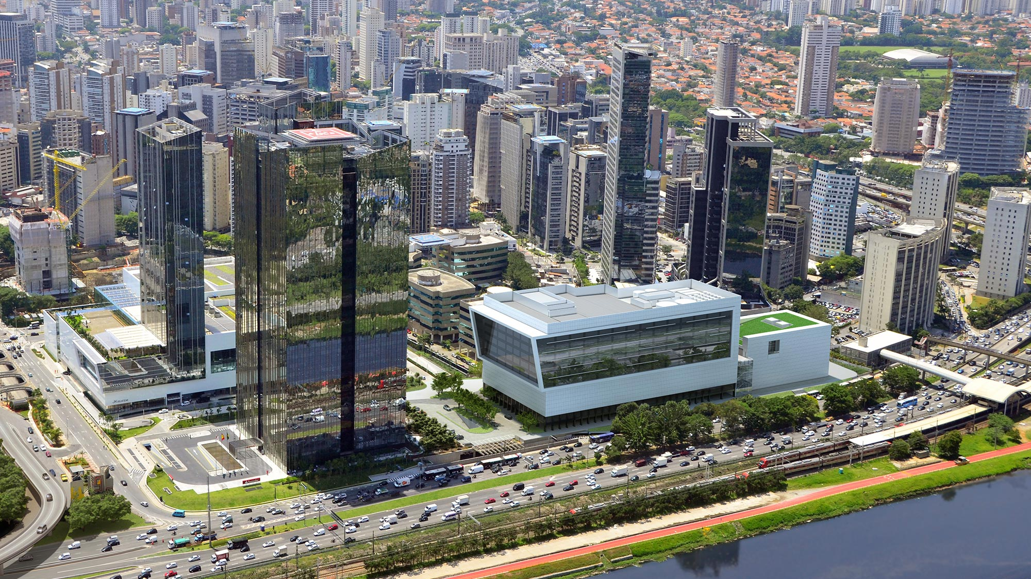


Bootcamp
SANTANDER

Slide 2
Angular trainning

Slide 3

apêndice

Slide 4

Style Guide e Best Pratices
https://angular.io/guide/styleguide
Cursos
https://loiane.training/course/angular/
https://www.udemy.com/curso-de-desenvolvimento-web-com-es6-typescript-e-angular-4
Podcast
Angular: Passado, Presente e Futuro: https://www.youtube.com/watch?v=g5KC7kRPotk
Meetup
https://www.meetup.com/pt-BR/AngularJS-Sao-Paulo/
GitHub Curso
https://github.com/BootCampAvanSanAnder

Slide 5
Bootcamp
SANTANDER

